Slide 1
Difference of Limit by reference standard of CE ~Conducted Emission~

Slide 2
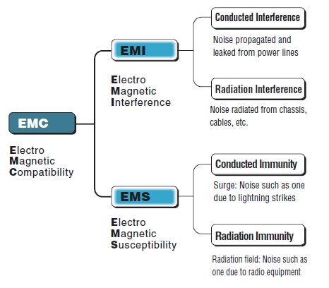
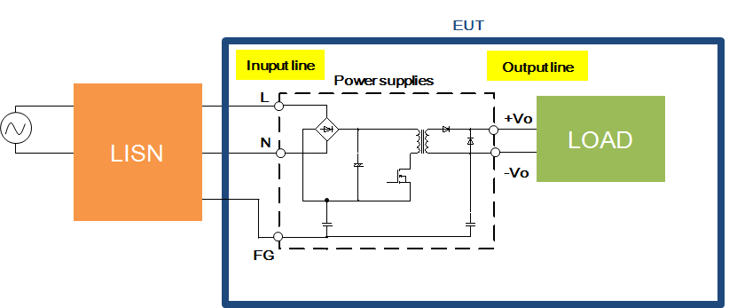
What is Conducted Emission?
Conducted emissions are electromagnetic energy created by a device and transmitted in the form of an electrical current through its power cord.
This can potentially cause problems since power cords are connected to the entire power distribution network.
Power cable
Power supply
Conductive noise
{
Common mode
Normal mode

Slide 3
How is Conducted Emission measured ?
Interfering voltage that is caused by an electrical current through its power cord, is measured by LISN(Line Impedance Stabilization Network).
Power cable
Power supply
Conductive noise
{
Common mode
Normal mode

Slide 4
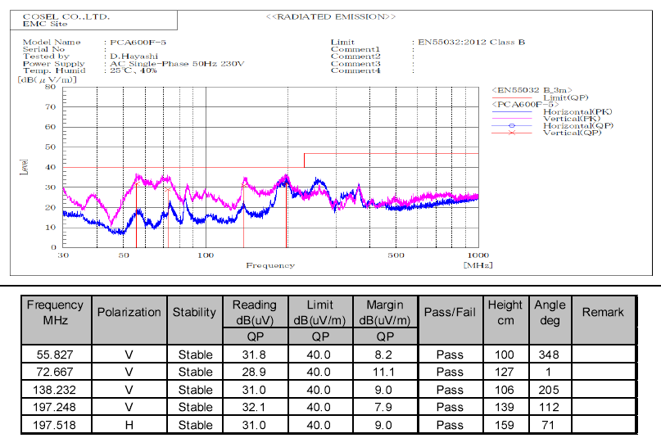
■初めに
・雑音端子とは
・横軸周波数、縦軸
・リミットを逸脱するとNG
Example of test result
Example of test result is shown as below(PCA600F-5).
The horizontal axis is the frequency, and the vertical axis is the noise level. Noise level shall be below the limit to comply the EMI standard.
Noise Level
BAD !
Noise Frequency

Slide 5
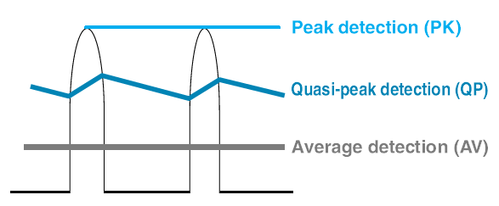
■初めに
・雑音端子とは
・横軸周波数、縦軸
・リミットを逸脱するとNG
Example of test result
There are three detection method is shown as below.
■Peak detection (PK)
The highest (peak) value of a waveform.
■Quasi-peak detection (QP)
Simply speaking, Quasi-peak is an intermediate value between peak and average. QP value becomes high when noise has a long duration or high value frequently.
Quasi-peaks is detected by a circuit that has time constants at the time of charge and discharge.
■Average detection (AV)
Average values of a waveform.

Slide 6
■初めに
・雑音端子とは
・横軸周波数、縦軸
・リミットを逸脱するとNG
Example of test result
There are two limit lines(QP and AVE). Noise level shall be below both limits to comply the EMI standard.
Limit(QP)
Limit(AV)
the measured value

Slide 7
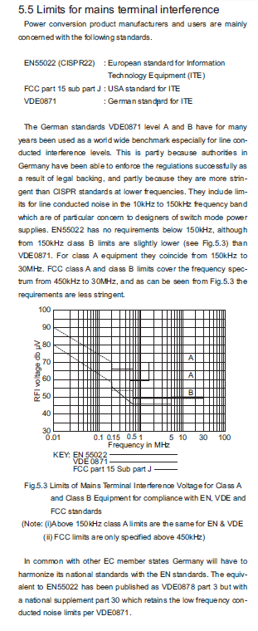
Name of EMI standard depending on the region
EMI standard name is different depending on the region.
The major standards are shown below.
: International Special Committee on Radio Interference
■ CISPR
: The Federal Communications Commission(U.S.A)
■ FCC
: Verband Deutscher Elektrotechniker(Germany)
■ VDE
■ VCCI
: Voluntary Control Council for Interference
by Information Technology Equipment(Japan)
・・・

Slide 8
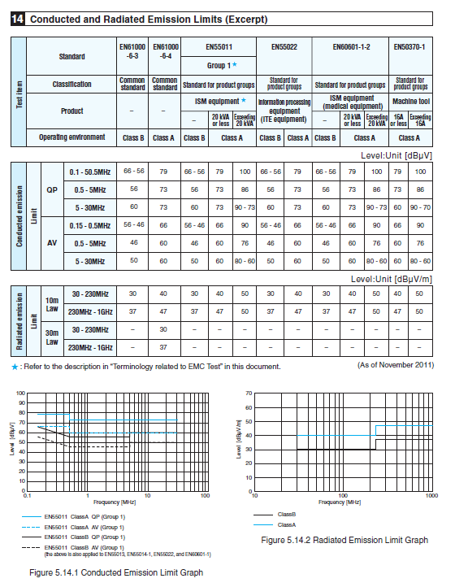
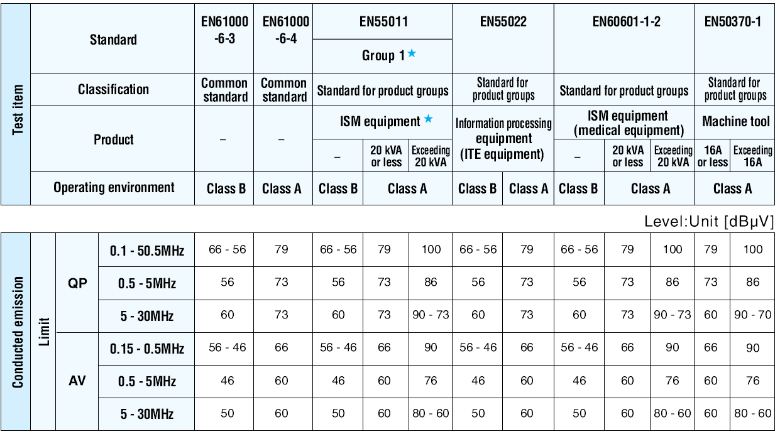
Limit level depending on the equipment
The limit value differs depending on the standard, and the limit value differs depending on the equipment. The limit value list for each standard is shown below.
Product

Slide 9
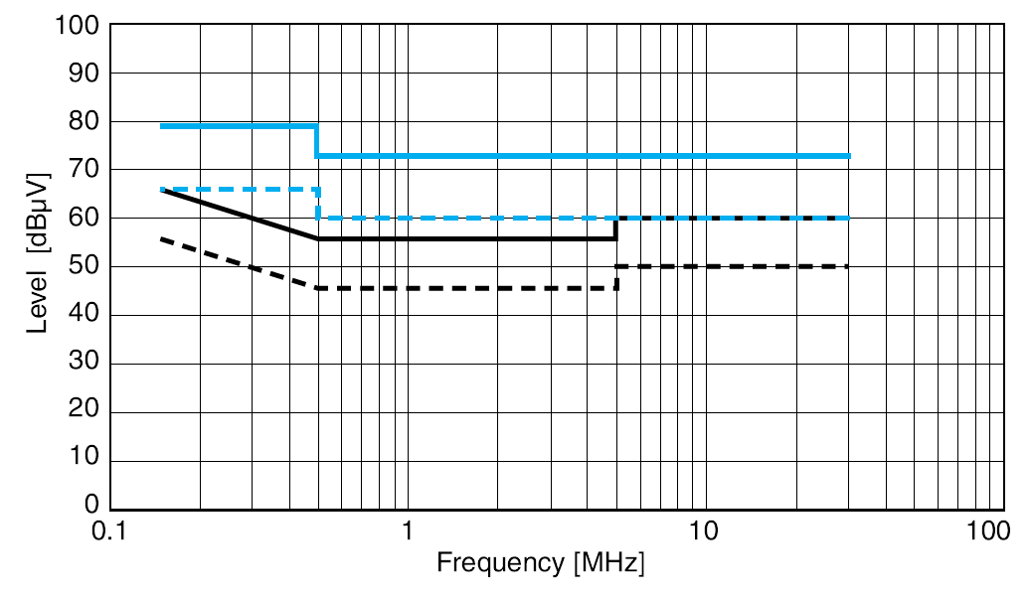
Limit level depending on the equipment
Assuming compliance with EN55011/55022, Cosel's power supplies are basically designed as bellow.
■Enclosed Type : Class B
■PCB Mount, Power module Type : Class A (with external parts)
* There are some exceptions, so please check the specification sheet for the detail.
＊ "Class B" is a stricter requirement
value than "Class A".
Fig Limits of EN55011

Slide 10
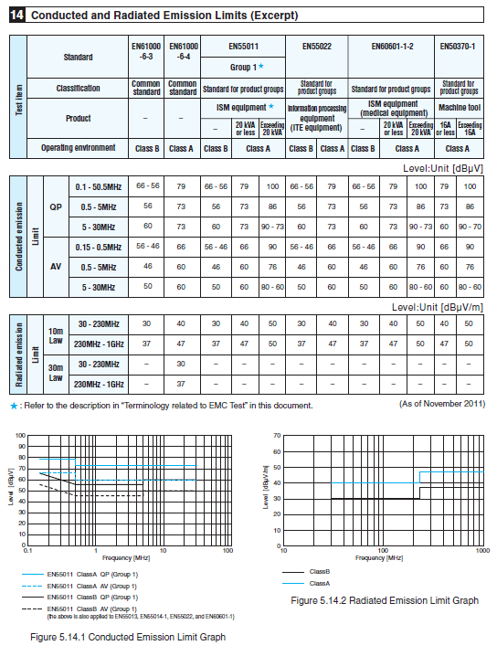
Summary
-The limit values is different depending on customer's equipment and region/country. -Depending on the customer's requirement, to add a filter circuit for noise reduction might be necessary.
For example, when the customer requests class B with Cosel’s power module. -When some customer has trouble with noise, please check the customer's requirement and limit value.

