Slide 1

How to design the size of heatsink

Slide 2
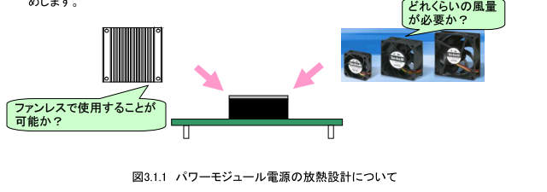
How to design the size of heatsink
To ensure operation of the power module, it is necessary to keep baseplate temperature within the allowable temperature limit.
The heat dissipation structure (the size of the heat sink and presence/absence of the fan etc.) also has an influence on the exterior and dimension of the equipment, and designing in advance is important.
Eventually, measuring the temperature with the actual application is required.
How much air volume is necessary?
Is it possible to use without a fan?
Fig.1 About heat radiation design of power modules

Slide 3
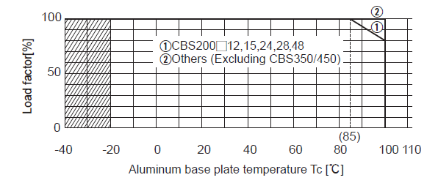
①Baseplate Temperature
The power module is designed for using within the derating curve shown in Figure 2.
For example, in the CBS series, the maximum temperature of baseplate at 100% load is 85℃ and should not exceed the derating curve.
Fig.2 Derating curves by the aluminum base plate temperature

Slide 4
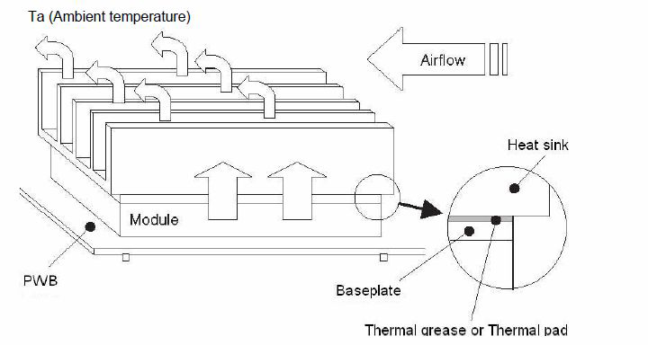
②Efficiency of Power Supply and Dissipation power
Not all of the input power is converted to output power, and some loss is dissipated as
heat from the power module.
To determine the internal power dissipation, 1 - 2 % margin of the efficiency shall be
considered to select sufficient heatsink.
Efficiency is defined as the percentage of Output power vs Input power.
Efficiency (E) depends on the input voltage and output current.
Refer to the TEST DATA.
Fig.3 Power supply efficiency and Dissipation power

Slide 5
③ Thermal resistance
In most applications, heat will be conducted from the baseplate into an attached heat sink.
The thermal resistance of heatsink shall be designed so that junction temperature becomes less than rated temperature by thermal calculation.
As shown in Fig.4, the heat dissipation and heatsink can be modeled as a thermal circuit.
Contact thermal resistance is between baseplate and heat sink.
To decrease the contact thermal resistance, please use thermal grease
(low thermal resistance (0.2 - 0.3℃/W).
The thermal grease shall apply to the baseplate thinly and uniformly..
Fig.4 Model of thermal resistance

Slide 6
④Heat sink mounting
The interface of the baseplate and heat sink is smooth, flat and free of debris.
If the heatsink and the baseplate aren't contacted sufficiently, contact thermal resistance would increase and heat radiation becomes insufficient.
Either thermal grease or thermal pads shall be used for sufficient thermal conduction.
To install the heat sink, screws shall be tightened at all four mounting holes.
When mounting heat sinks to modules, screws shall be tightened uniform torque.
The following tightening order should be applied.
Fig.5 Heat sink mounting
Fig.6 Tightening order
Notes:
Please tighten the screw under the maximum torque.

Slide 7
⑤Installation of modules
Mount the module not to block airflow
for other modules
Use a heat sink with vertical fins along the natural convection.
Avoid blocking the airflow to the modules with other components.
Fig.7 Installation of modules

Slide 8
Thermal design example
The following process describes thermal design with an example of CBS504805.

Slide 9
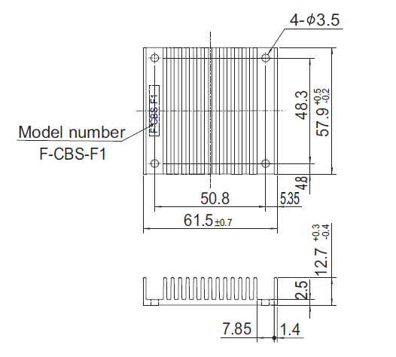
Thermal design example
Fig.10
Fig.9 F-CBS-F1 (external view)
Fig.10 Heat sink thermal resistance curves

Slide 10
Thermal design example

Slide 11
Thermal design example
The following process describes thermal design with an example of TUNS700F28.

Slide 12
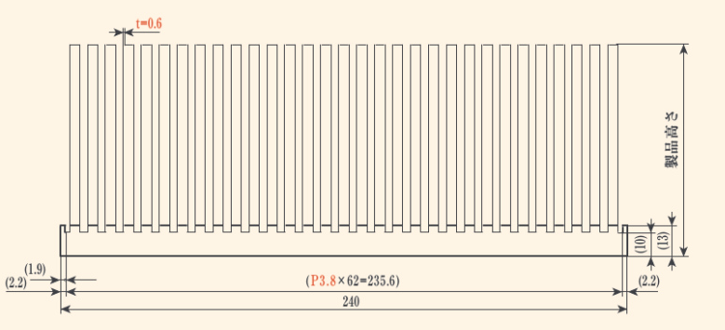
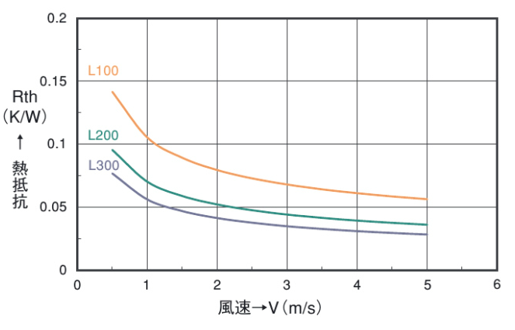
Thermal design example
Cutting dimension
（℃/W）
H ＝ 50㎜
Thermal resistance
wind velocity (m/s)
Fig.12 50WC240-L200T4P27 (Sankyo Thermo-Tech,lnc.)
Fig.13 Heat sink thermal resistance curves

Slide 13
Thermal design example

Slide 14
Thermal design example
Fig.14 Heat sink mounting of CBS504805
Fig.15 Heat sink mounting of TUNS700F48
High power module power supply requires a large heat sink as the internal
loss increases.

